Slide 1
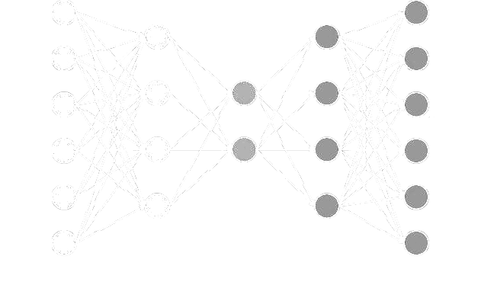
Quantifying The Dimensionality Of Image Manifold For Classification
DEEPALI BIDWAI, HOMERO ESMERALDO, MENNAT ALLAH KHALIFA, MOHAMED GAMAL, PAWAN THAPALIYA, TULIKA KHARGONKAR
AWESOME MENTORS: MOBIN NESARI, REZA RAJABLI
THE MORRIGAN | 7-LAYER PERCEPTRON

Slide 2
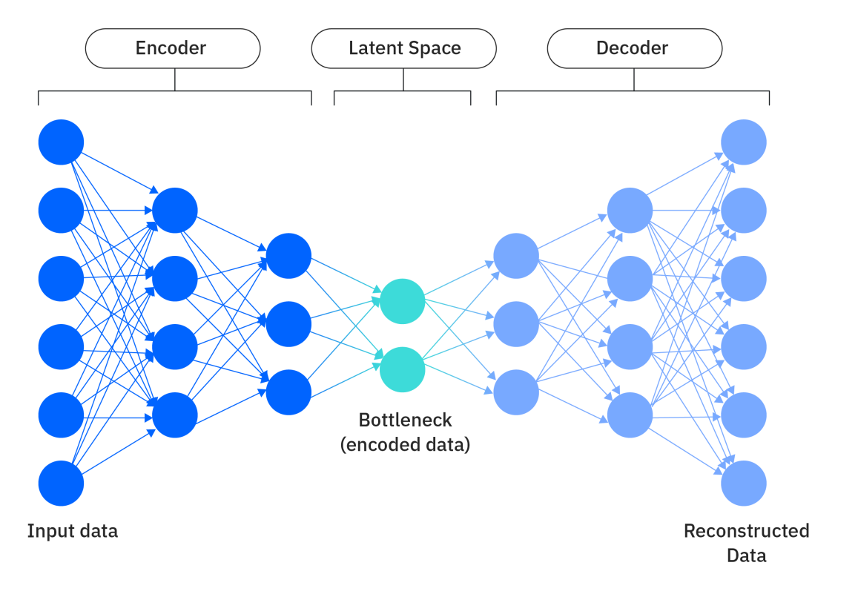


Introduction
Why quantify dimensionality of a dataset?
Manifold Hypothesis: A low dimensional manifold can approximate the dataset embedded in a high dimensional space (Causin & Marta, 2025).
Dimensionality of input affects representations of networks trained on it (Huh et al, 2024).
256
256
512
512
?
Notes:
Homero

Slide 3
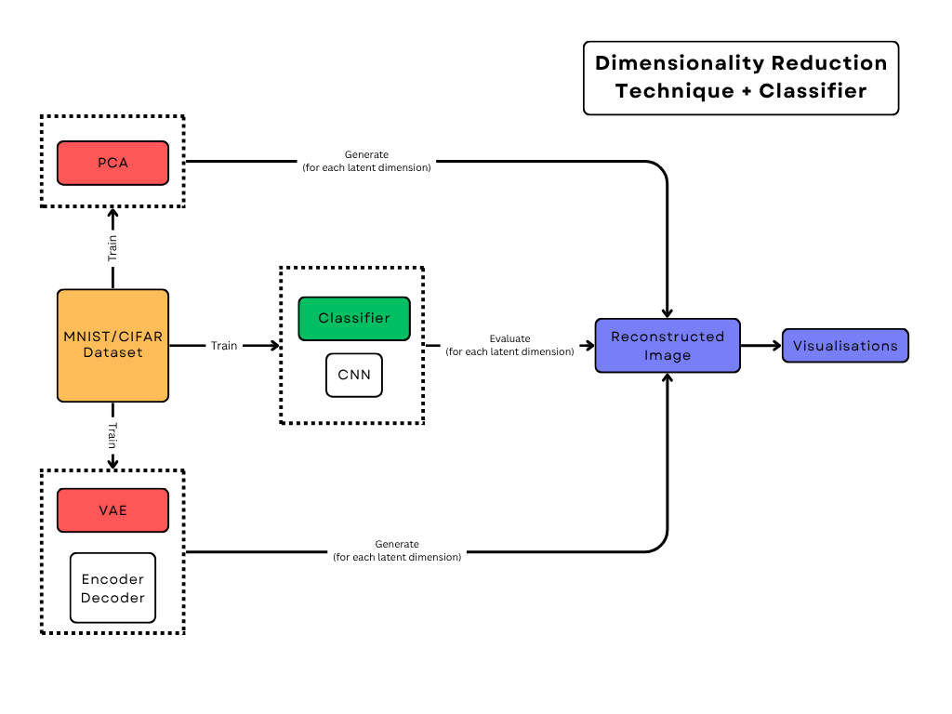
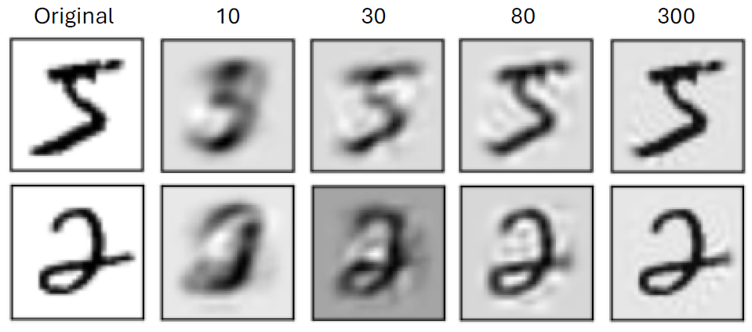
Experiment
Pipeline
Notes:
Deepali

Slide 4
Results

Slide 5
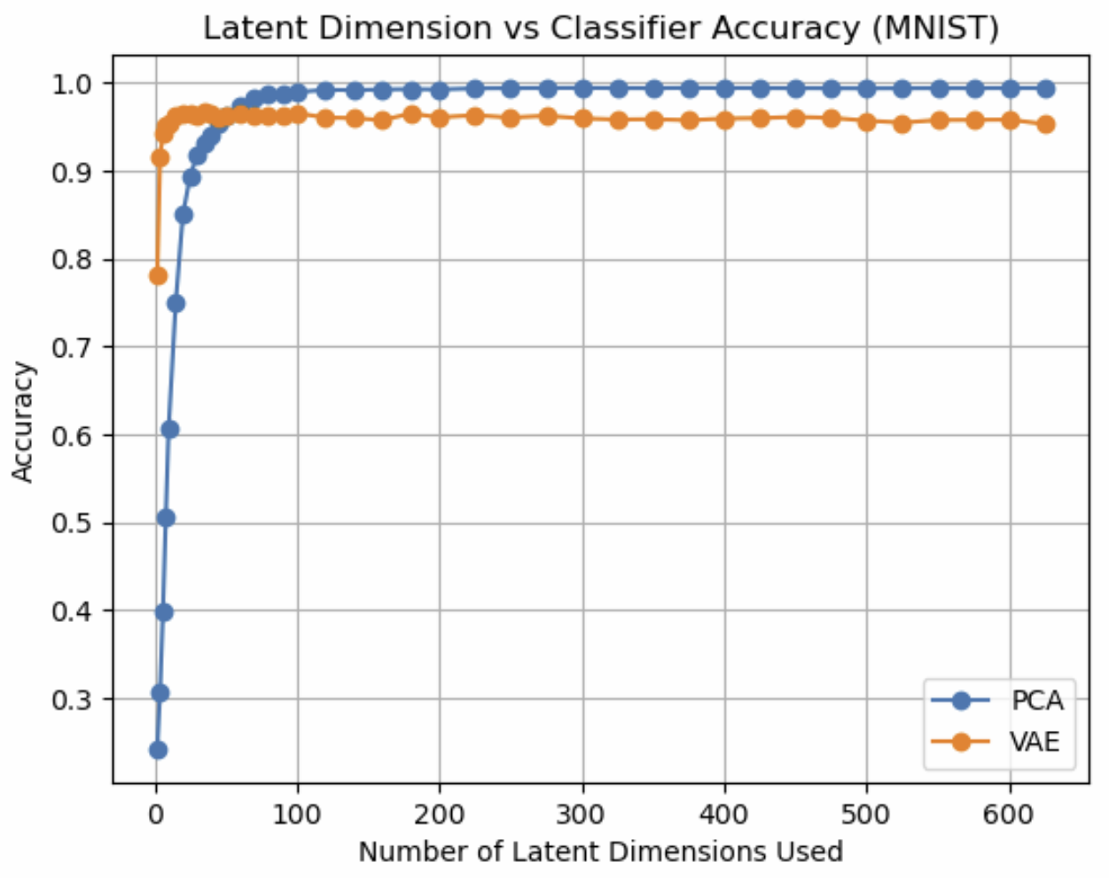
PCA vs VAE
Example reconstructed images
Test accuracy rises with latent size, then plateaus.
VAE rises much earlier than PCA (nonlinear technique is more powerful)
PCA has higher accuracy at the plateau
Notes:
Mohamed

Slide 6
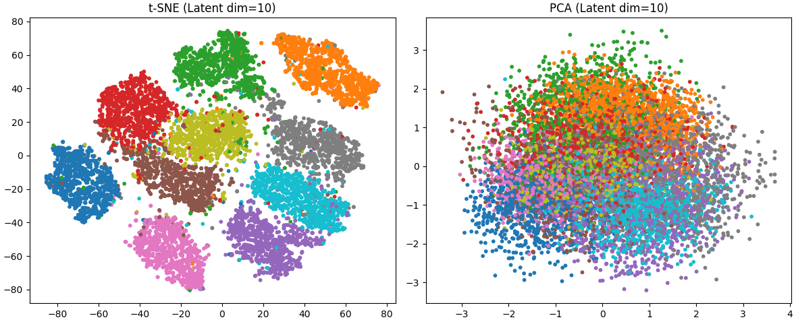
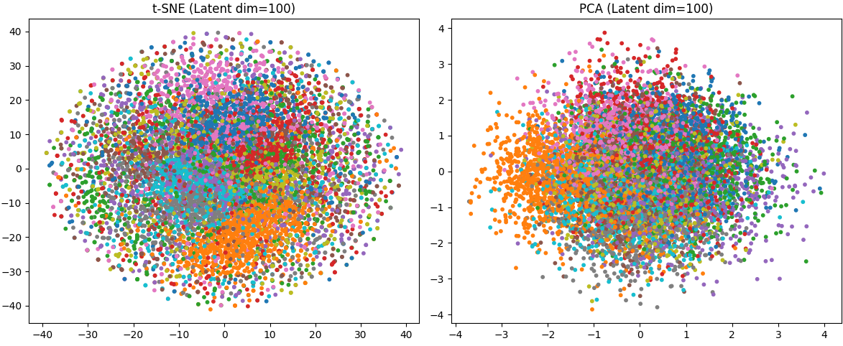
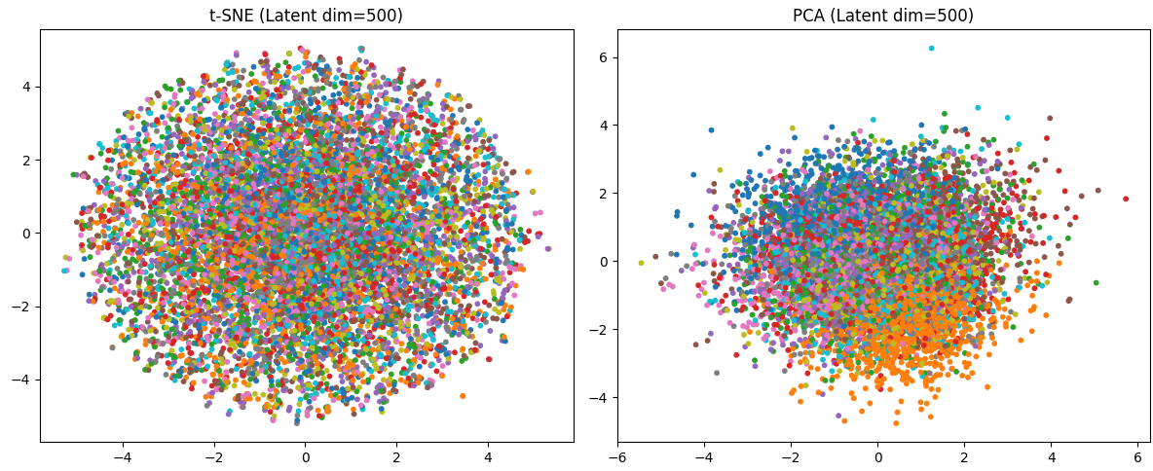
Effect of Latent Dimension on Latent Space Structure (MNIST)
t-SNE
t-SNE shows clear clusters at low latent dims.
Clusters blur at high dims, showing less structure.
Tradeoff: small latent spaces compress well; large ones better reconstruct but not always classify
Notes:
Pawan

Slide 7
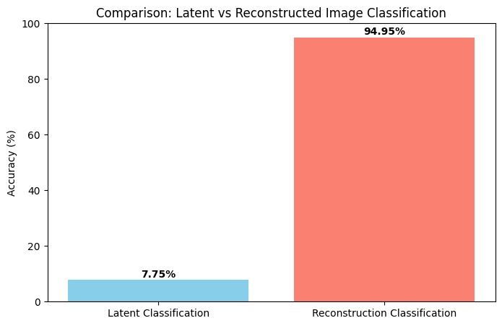
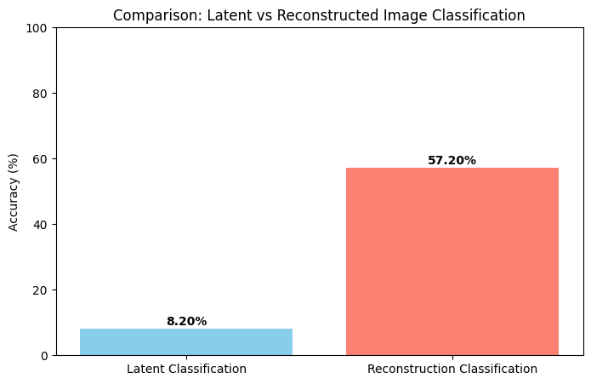
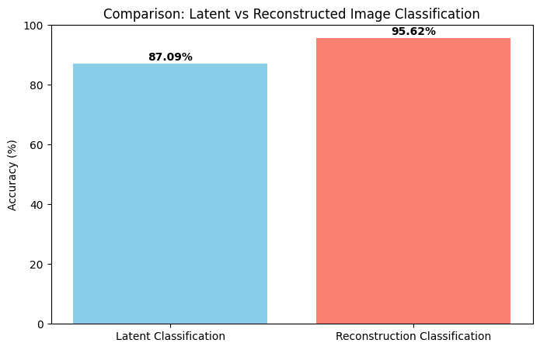
β-VAE
We manipulated Loss function parameters to understand how it affects classification of the reconstructed images and of the bottleneck features
Loss Function = BCE + beta * KLD + alpha * CE
Classifiability of the bottleneck
Reconstruction
Bottleneck distribution regularization (Gaussian)
alpha=0, beta=1
alpha=0, beta=10.0
alpha=1, beta=1
Increasing beta collapses representations in the bottleneck and harms classification accuracy
Including bottleneck classification in the loss increases its classifiability
Bottleneck features are not linearly classifiable
Notes:
Mohamed
BCE: Reconstruction Loss
KLD: KL Divergence (latent space) - beta hyperparameter
CE: Classification Loss (Cross Entropy) - alpha hyperparameter

Slide 8
Conclusion
VAE can represent images with fewer latent dimensions than PCA, preserving classification accuracy for low dimensional latent space
PCA does better than VAE at higher dimensions
Better understanding of manifold dimensionality by comparing VAE and PCA
Notes:
Tulika

Slide 9
In the next episode…
We’re closer to quantifying latent dimensionality but not entirely
Why is VAE’s accuracy lower than PCA at higher dimensions? Can it potentially change with different VAE modifications?
How do these results change with more complex datasets?
Notes:
Tulika - is it noise encoding?
- time and resource constraints
- we were able to explore some aspects like the beta VAEs, but there are a lot of moving parts that we would like to look into. VQ VAEs?

Slide 10
Thank you to our colleagues, TAs and NMA!

Slide 11
Appendix

Slide 12
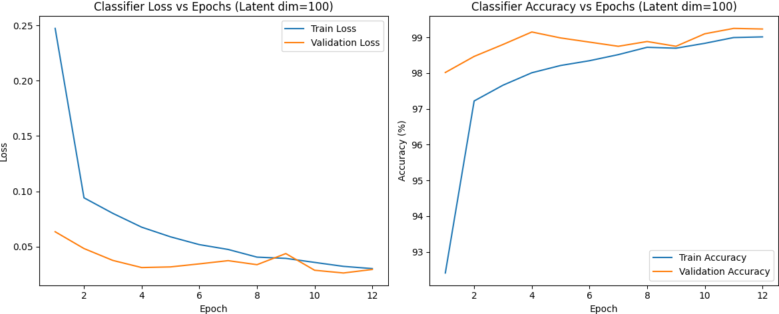
Training
No overfitting:

Slide 13
VAE architecture
BatchNorm1d, ReLU
512
256
256
512

Slide 14
Classifier
nn.Conv2d(1, 32, kernel_size=3, padding=1),
nn.BatchNorm2d(32),.ReLU(), nn.MaxPool2d(2, 2),
nn.Conv2d(32, 64, kernel_size=3, padding=1),
nn.BatchNorm2d(64), .ReLU(), .MaxPool2d(2, 2),
nn.Flatten(),
nn.Linear(64 * 7 * 7, 128),
nn.ReLU(),
nn.Dropout(0.25),
nn.Linear(128, 10)

Slide 15
t-SNE | PCA

